Slide 1
Data Management Technologies
IS465: Data Management and Governance

Slide 2
Outline
Introduction

Slide 3
Introduction

Slide 4
Data Management Technologies: An Overview
Data management technologies refer to the tools and systems used to collect, store, organize, and manage data across various industries and applications.
Effective data management is crucial for making informed decisions, optimizing processes, and ensuring data security and privacy.

Slide 5
Types of Data Management Technologies
Data storage technologies
Systems used to store and retrieve data, such as relational databases, NoSQL databases, and data warehouses. Examples include MySQL, MongoDB, and Amazon Redshift.
Data processing technologies
Tools used to process, transform, and analyze data, such as data integration, data cleansing, and data mining. Examples include Apache NiFi, Talend, and RapidMiner.

Slide 6
Types of Data Management Technologies
Data governance technologies
Systems used to manage data quality, security, and privacy, such as data catalogs, data dictionaries, and data access control. Examples include Apache Atlas, AWS Lake Formation, and DataClarity.
Data visualization technologies
Tools used to create interactive and intuitive visualizations of data, such as business intelligence, data analytics, and data dashboards. Examples include Tableau, Power BI, and QlikView.

Slide 7
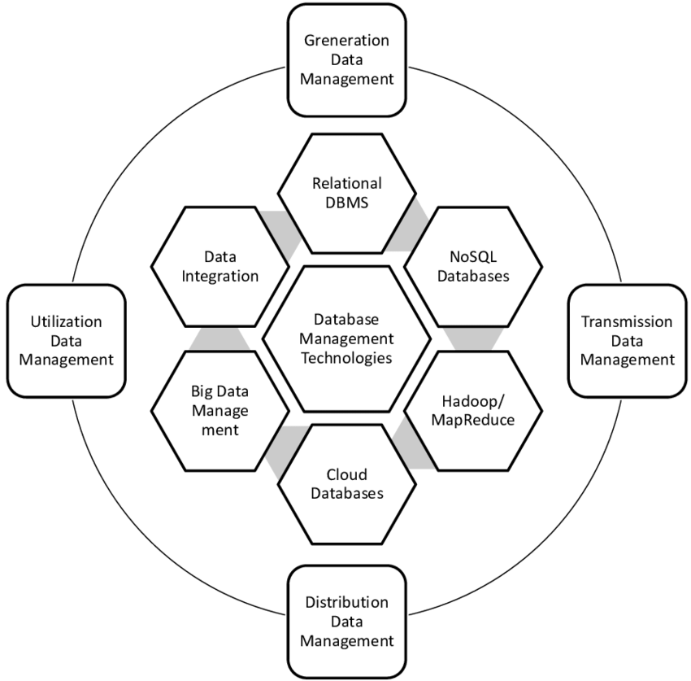
Modern database management technologies

Slide 8
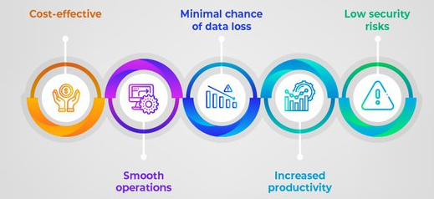
Importance of Data Management Technologies
Data management technologies are critical for organizations to collect, store, process, and analyze large volumes of data.
Data-driven decision making has become a norm in today's business landscape.
Data management technologies help organizations to make informed decisions, improve operational efficiency, and stay competitive.

Slide 9
Improving Business Outcomes
Data management technologies help organizations to:
Improve data quality and accuracy
Enhance data security and privacy
Increase operational efficiency and productivity
Improve customer experience and satisfaction
Make informed decisions based on data insights
Stay competitive in the marketplace

Slide 10
Improving Business Outcomes
Data management technologies also enable organizations to:
Identify new business opportunities
Optimize business processes
Improve financial performance
Enhance strategic decision making

Slide 11
Types of Data Management Technologies
Data storage technologies:
Relational databases (e.g., MySQL, Oracle)
NoSQL databases (e.g., MongoDB, Cassandra)
Data warehouses (e.g., Amazon Redshift, Google BigQuery)
Data lakes (e.g., Apache Hadoop, AWS S3)
Data processing technologies:
Data integration (e.g., Talend, Informatica)
Data cleansing (e.g., Trifacta, DataClarity)
Data transformation (e.g., Apache Beam, AWS Lambda)
Data streaming (e.g., Apache Kafka, AWS Kinesis)

Slide 12
Types of Data Management Technologies
Data governance technologies:
Data catalogs (e.g., Apache Atlas, AWS Lake Formation)
Data dictionaries (e.g., Apache Hive, AWS Glue)
Data access control (e.g., Apache Ranger, AWS IAM)
Data analytics technologies:
Business intelligence (e.g., Tableau, Power BI)
Data visualization (e.g., D3.js, Matplotlib)
Predictive analytics (e.g., R, Python)
Machine learning (e.g., TensorFlow, PyTorch)

Slide 13
Key Features and Use Cases
Technology | Key Features | Use Cases
Relational databases | SQL querying, data consistency, transaction management, data security | Traditional data storage and management Online transactions and e-commerce Enterprise data management
NoSQL databases | Scalability, flexible schema, high availability, big data analytics | Big data storage and processing Real-time web analytics IoT data management
Cloud storage | Scalability, cost-effectiveness, data accessibility, collaboration | File sharing and collaboration Backup and archiving Cloud-based data storage
Data warehousing | Data integration, data cleansing, data transformation, data mining | Data analysis and reporting Business intelligence Data-driven decision making
Data lakes | Data storage, data processing, data analytics, data visualization | Big data storage and processing Data science and machine learning Data-driven decision making

Slide 14
Key Features and Use Cases
Technology | Key Features | Use Cases
Data governance | Data quality, data security, data compliance, data accessibility | Data management and oversight Data risk management Data privacy and protection
Master data management | Data integration, data cleansing, data transformation, data security | Data management and oversight Data quality and consistency Data-driven decision making
Data integration | Data integration, data transformation, data mapping, data validation | Data migration and integration Data synchronization and replication Data integration for analytics
Data quality | Data validation, data cleansing, data normalization, data enrichment | Data quality and consistency Data accuracy and completeness Data-driven decision making
Data security | Data encryption, data access controls, data authentication, data backup | Data protection and privacy Data risk management Compliance and regulatory requirements
Data backup | Data backup and recovery, data archiving, data retention, data restore | Data protection and recovery Data backup and archiving Compliance and regulatory requirements
Data analytics | Data visualization, data mining, data predictive analytics, data prescriptive analytics | Data-driven decision making Business intelligence Predictive and prescriptive analytics

